Slide 1
Object-oriented Programming
Week 11 | Lecture 1

Slide 2
Generic Functions
A generic function defines a general set of operations that will be applied to various types of data. The type of data that the function will operate upon is passed to it as a parameter
A single general procedure can be applied to a wide range of data

Slide 3
Generic Functions
A generic function is created using the keyword template
A generic function is also called a template function

Slide 4
Templates in C++
Templates are the foundation of generic programming, which involves writing code in a way that is independent of any particular type.
Templates are powerful features of C++ which allows you to write generic programs. A template is a blueprint or formula for creating a generic class or a function.
In simple terms, you can create a single function or a class to work with different data types using templates.
Templates are often used in larger codebase for the purpose of code reusability and flexibility of the programs.

Slide 5
What is the difference between function overloading and templates?
Both are used to achieve Compile time Polymorphism
Both function overloading and templates are examples of polymorphism feature of OOP. Function overloading is used when multiple functions do similar operations, templates are used when multiple functions do identical operations. You can use overloading when you want to apply different operations depending on the type. Templates provide an advantage when you want to perform the same action on types that can be different

Slide 6
How templates work?
Templates are expanded at compiler time. This is like macros. The difference is, compiler does type checking before template expansion. The idea is simple, source code contains only function/class, but compiled code may contain multiple copies of same function/class.

Slide 7
Types
The concept of templates can be used in two different ways:
Function Templates
Class Templates

Slide 8
Generic Functions/Function Templates
A function template works in a similar to a normal function, with one key difference.
A single function template can work with different data types at once but, a single normal function can only work with one set of data types.
Normally, if you need to perform identical operations on two or more types of data, you use function overloading to create two functions with the required function declaration.

Slide 9
A function template starts with the keyword template followed by template parameter/s inside < > which is followed by function declaration.
template <class T>
T someFunction(T arg)
{
... .. ...
}

Slide 10
Generic Functions/Function Templates
You can write both statements in a single line:
template <class T> ret-type func-name(parameters)
{
// body of function
}
T is a placeholder that the compiler will automatically replace with an actual data type

Slide 11
You can also use keyword typename instead of class in the above example.
template <typename T>
T someFunction(T arg)
{
... .. ...
}

Slide 12
How to call a function template?
We can call the template function a couple of ways. Firstly, we can call it by explicitly specifying the type like so
//Explicit type parametrizing.
int myint = 5;
someFunction<int>(myint);
double mydouble = 99.9;
someFunction<double>(mydouble);

Slide 13
Implicit type parametrizing
However with template function the compiler can determine the parametrizing types when we don't provide them, hence we can also call someFunction() like so
int myint = 5;
someFunction() <>(myint);

Slide 14
Implicit type parametrizing
double mydouble = 99.9;
someFunction(mydouble);
The first call with empty angle brackets tells the compiler that we are calling a template function and the second call leaves it up to the compiler to infer.

Slide 15
Example
template <class X> void SimplePrint (X a)
{
cout << “Parameter is: ” << a;
}
int main()
{
int i = 20; char c = ‘M’; float f = 5.5;
SimplePrint ( i ); SimplePrint ( c ); SimplePrint ( f );
}

Slide 16
Example
template <class T> void swapargs(T &a, T &b)
{
T temp;
temp = a;
a = b;
b = temp;
}
int main()
{
int i=10, j=20; double x=10.1, y=23.3; char a='x', b='z';
swapargs(i, j); // swap integers
swapargs(x, y); // swap floats
swapargs(a, b); // swap chars
}

Slide 17
Syntax
The line:
template <class X> void swapargs(X &a, X &b)
can also be written in two consecutive lines as:
template <class X> void swapargs(X &a, X &b) { \\ function body }
Note: But no other statement can occur between the two
lines

Slide 18
Function template with more than one type parameter
In above example you can only use single data type what if you want to use combination of data types
// 2 type parameters:
template<class T1, class T2>
void someFunc(T1 var1, T2 var2 )
{
// some code in here...
}

Slide 19
Function with Two Generic Types
You can define more than one generic data type in the template statement by using a comma-separated list
template <class T1, class T2> void myfunc(T1 a, T2 b) { cout << a << “ & ” << b << '\n'; }

Slide 20
Can you have unused type parameters?
No, you may not. If you declare a template parameter then you absolutely must use it inside of your function definition otherwise the compiler will complain. So, in the example above, you would have to use both T1 and T2, or you will get a compiler error.

Slide 21
Output?
#include <iostream>
using namespace std;
template <class T1, class T2>
void myfunc(T1 a){
cout << a << '\n';}
int main () {
myfunc(2);
return 0;
}

Slide 22

Output?

Slide 23
Output?
#include <iostream>
using namespace std;
template <class T1, class T2>
void myfunc(){
}
int main () {
myfunc();
return 0;
}

Slide 24
Output?
#include <iostream>
using namespace std;
template <class T1, class T2>
void myfunc(T1 a, T1 b)
{
cout << a << " & " << b << '\n';
}
int main () {
myfunc(3,4);
return 0;
}

Slide 25

Output?

Slide 26
Output?
#include <iostream>
using namespace std;
template <class T1, class T2>
void myfunc(T1 a, T2 b)
{
cout << a << " & " << b << '\n';
}
int main () {
myfunc(3,4.5);
return 0;
}

Slide 27
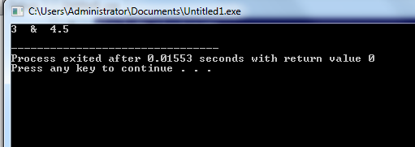
Output?

Slide 28
Default arg
#include <iostream>
using namespace std;
template <typename T, typename U = int>
void display(T value, U times = 1) {
cout << value<< endl ;
cout << times<< endl;}
int main() {
display<string>("Hello"); // OK: T = string, U = int (default)
display(3.14 ); // OK: T = double, U = int
}

Slide 29
Explicitly Overloading a Generic Function/Specializing templates
We can explicitly overload a generic function
If you overload a generic function, that overloaded function "hides" the generic function relative to that specific version
This is formally called explicit specialization

Slide 30
Explicitly Overloading a Generic Function/Specializing templates
Normally when we write a template class or function we want to use it with many different types, however sometimes we want to code a function or class to make use of a particular type more efficiently this is when we use a template specialization. To declare a template specialization we still use the template keyword and angle brackets <> but leave out the parameters like so.
template<>

Slide 31
Example
template <class X> void func (X a) { cout << “Hello every data type: ” << a; }
// Following version hides generic version if parameter is int
void func (int a) { cout << “Hello integers: ” << a; }

Slide 32
Alternate Syntax
A new-style syntax can also be used to denote the explicit specialization of a function:
template < > void func <int> (int a) { cout << “Hello integers: ” << a; }

Slide 33
#include <iostream>
using namespace std;
// General template function
template <class T>
void func(T a)
{
cout << "General Data: " << a << endl;
}
// Explicit specialization for int
template <>
void func<int>(int a)
{
cout << "Hello integers: " << a << endl;
}
int main()
{
func<double>(3.14); // Calls general template
func<char>('A'); // Calls general template
func<int>(100); // Calls specialized version for int
return 0;
}

Slide 34
❌ Not Allowed:
// INVALID: cannot specialize for both int and char in one
template <>
void func<int, char>(int a, char b) { ... }
Templates can only be explicitly specialized per concrete type or signature. If you need combined behavior (e.g., a function that takes both int and char), you can:
Use overloading or
Create a template with two parameters and specialize that.

Slide 35
#include <iostream>
using namespace std;
// General template function with two type parameters
template <class T1, class T2>
void func(T1 a, T2 b){
cout << "General Template: " << a << " and " << b << endl;}
// Specialization for <int, char>
template <>
void func<int, char>(int a, char b){
cout << "Specialized for <int, char>: " << a << " and " << b << endl;
}
// Specialization for <char, int> (optional)
template <>
void func<char, int>(char a, int b){
cout << "Specialized for <char, int>: " << a << " and " << b << endl;}
int main(){
func(10.5, 'A'); // General template <double, char>
func(100, 'X'); // Specialized <int, char>
func('Y', 200); // Specialized <char, int>
func("Hello", 3.14); // General template <const char*, double>
return 0;}

Slide 36
Alternate Syntax
template < > void func (int a) { cout << “Hello integers: ” << a; }

Slide 37
Overloading a Generic Function
In addition to creating explicit, overloaded versions of a generic function, you can also overload the template specification itself
To do so, simply create another version of the template that differs from any others in its parameter list

Slide 38
Example
// First version of f() template
template <class X> void f(X a)
{
cout << "Inside f(X a)";
}
// Second version of f() template
template <class X, class Y> void f(X a, Y b)
{
cout << "Inside f(X a, Y b)";
}
int main()
{
f(10); // calls f(X) f(10, 20); // calls f(X, Y)
}

Slide 39
Using Normal Parameters in Generic Functions
You can mix non-generic parameters with generic parameters in a template function:
template<class X> void func(X a, int b)
{
cout << “General Data: ” << a;
cout << “Integer Data: ” << b;
}

Slide 40
#include <iostream>
using namespace std;
// Template function with a generic type X and a non-generic int parameter
template <class X>
void func(X a, int b)
{
cout << "General Data: " << a << endl;
cout << "Integer Data: " << b << endl;
}
int main()
{
// Call with different types for 'a' and int for 'b'
func(3.14, 10); // X is double
func("Hello", 20); // X is const char*
func('A', 30); // X is char
func("Test", 40); // X is std::string
return 0;
}

Slide 41
// Explicit template type calling
func<double>(3.14, 10); // X = double
func<const char*>("Hello", 20); // X = const char*
func<char>('A', 30); // X = char
func<string>(string("Test"), 40); // X = std::string

Slide 42
Use of Generic Functions
Generic functions are similar to overloaded functions except that they are more restrictive
When functions are overloaded, you may have different actions performed within the body of each function. But a generic function must perform the same general action for all versions

Slide 43
Common Applications
Sorting
Compacting an array
Searching

Slide 44
Generic Classes
In addition to generic functions, you can also define a generic class
The actual type of the data being used (in class) will be specified as a parameter when objects of that class are created
Generic classes are useful when a class uses logic that can be generalized e.g. Stacks, Queues

Slide 45
Generic Classes
The general form of a generic class declaration is shown here:
template <class T> class class-name
{
. . .
}

Slide 46
Generic Classes
If necessary, we can define more than one generic data type using a comma-separated list
We create a specific instance of that class using the following general form:
class-name <type> ob;

Slide 47
#include <iostream>
using namespace std;
// Generic class definition
template <class T>
class Box {
private:
T value;
public:
Box(T val) : value(val) {}
void show() {
cout << "Box contains: " << value << endl;
}
};
int main() {
Box<int> intBox(42); // Box for int
Box<double> doubleBox(3.14); // Box for double
Box<string> strBox("Hello"); // Box for string
intBox.show();
doubleBox.show();
strBox.show();
return 0;
}

Slide 48
Example
template <class T1, class T2> class myclass
{
T1 i;
T2 j;
public:
myclass (T1 a, T2 b) { i = a; j = b; }
void show( ) { cout << i << “ & ” << j; }
};

Slide 49
Example (cont.)
int main()
{
myclass<int, double> ob1(10, 0.23);
myclass<char, char *> ob2('X', “Hello”);
ob1.show(); // show int, double
ob2.show(); // show char, char *
}

Slide 50
#include <iostream>
using namespace std;
template <class T1, class T2>
class MyClass {
T1 i;
// T2 j; // <-- Unused parameter (commented out)
public:
MyClass(T1 a, T2 b) {
i = a;
// j = b; // Not used
}
void show() {
cout << "Only T1 used: " << i << endl;
}};
int main() {
MyClass<int, char> obj(100, 'X');
obj.show();
return 0;}

Slide 51
❌ Invalid: Only one type provided
MyClass<int> obj(10, 'A'); // ERROR: second template argument missing

Slide 52
Use default template argument for T2
template <class T1, class T2 = int>
class MyClass {
T1 i;
T2 j;
public:
MyClass(T1 a, T2 b) {
i = a;
j = b;
}
void show() {
cout << i << " & " << j << endl;
}
};
int main() {
MyClass<double> obj1(3.14, 42); // Uses default T2 = int
MyClass<double, char> obj2(3.14, 'Z'); // Explicit types
obj1.show();
obj2.show();
}

Slide 53
Example Program of Class Template
template <class T>
class mypair {
T a, b;
public:
mypair (T first, T second)
{a=first; b=second;}
T getmax ();};
template <class T>
T mypair<T>::getmax (){
T retval;
retval = a>b? a : b;
return retval;}
int main () {
mypair <int> myobject (100, 75);
cout << myobject.getmax();
return 0;}

Slide 54
Using Non-Type Arguments with Generic Classes
In a generic class, we can also specify non-type arguments:
template <class T, int size> class MyClass
{
T arr[size]; // length of array is passed in size
// rest of the code in class
}

Slide 55
Example (cont.)
int main()
{
atype<int, 10> intob;
atype<double, 15> doubleob;
}

Slide 56
Using Non-Type Arguments with Generic Classes
Non-type parameters can only be of type integers, pointers, or references
The arguments that you pass to a non-type parameter must be an integer constant

Slide 57
Output?
template <class T ,int i>
class mypair {
T a, b;
public:
mypair ()
{a=0;
b=0;}
};
int main () {
int a=2;
mypair <int , a> myobject;
return 0;
}

Slide 58


Slide 59
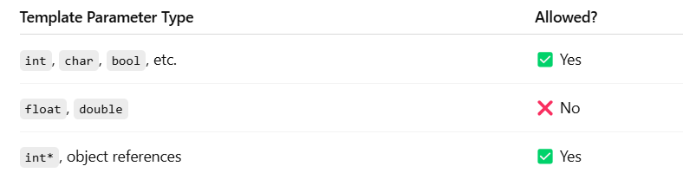

Slide 60
Using Default Arguments with Template Classes
A template class can be given a default argument:
template <class X=int> class myclass { //... };
and also like this:
template <class X, int size=10> class myclass { //… };

Slide 61
Using Default Arguments with Template Classes
#include <iostream>
using namespace std;
template <class T=int>
class mypair {
T a, b;
public:
mypair ()
{a=0;
b=0;}
};
int main () {
mypair <> myobject;
return 0;
}

Slide 62
Output?
#include <iostream>
using namespace std;
template <class T=int>
class mypair {
T a, b;
public:
mypair ()
{a=0;
b=0;}
};
int main () {
mypair myobject;
return 0;
}

Slide 63
Example (cont.)
int main()
{
myclass <100> intArray;
myclass <double> doubleArray;
myclass <> defArray;
}

Slide 64
Explicit Class Specializations
Just like generic functions, we can also create an explicit specialization of a generic class
To do so, use the template<> construct

Slide 65
Explicit Class Specializations
For other data types:
template <class T> class myclass { //… };
For integers:
template <> class myclass<int> { //… };

Slide 66
Specializing class templates
template <> class mycontainer <char> { ... };
First of all, notice that we precede the class template name with an empty template<> parameter list. This is to explicitly declare it as a template specialization. But more important than this prefix, is the <char> specialization parameter after the class template name. This specialization parameter itself identifies the type for which we are going to declare a template class specialization (char). Notice the differences between the generic class template and the specialization:

Slide 67
template <class T>
class Test
{
public:
Test(){
cout << "General template object \n";}
};
template <>
class Test <int>{
public:
Test(){
cout << "Specialized template object\n";}};
int main(){
Test<int> a;
Test<char> b;
Test<float> c;
return 0;}

Slide 68
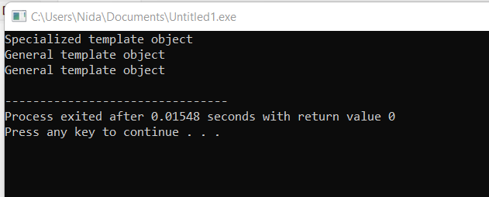

Slide 69
explicit specialization of a generic class only takes 1 type
#include <iostream>
using namespace std;
template <class T>
class Test
{
public:
Test(){
cout << "General template object \n";}
};
template <>
class Test <int,char>{
public:
Test(){
cout << "Specialized template object\n";}};
int main(){
Test<int , char> a;
Test<float> c;
return 0;}

Slide 70
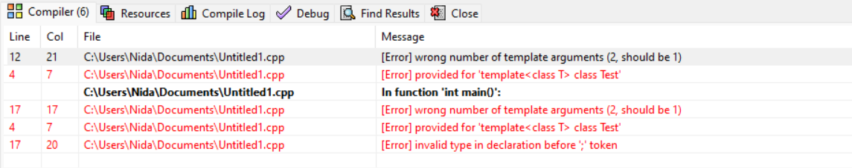

Slide 71
Template specialization for multiple types
#include <iostream>
using namespace std;
template <class T , class V>//take 2 placeholder for multiple types
class Test
{
public:
Test(){
cout << "General template object \n";}
};
template <>
class Test <int,char>{
public:
Test(){
cout << "Specialized template object\n";}};
int main(){
Test<int , char> a;
Test<float , short> c;
return 0;}

Slide 72
Another possibility with 2 specialized classes
#include <iostream>
using namespace std;
template <class T>
class Test
{
public:
Test(){
cout << "General template object \n";}
};
template <>
class Test <int>{
public:
Test(){
cout << "Specialized1 template object\n";}};
template <>
class Test <char>{
public:
Test(){
cout << "Specialized2 template object\n";}};
int main(){
Test<int> a;
Test<char> c;
return 0;}

Slide 73
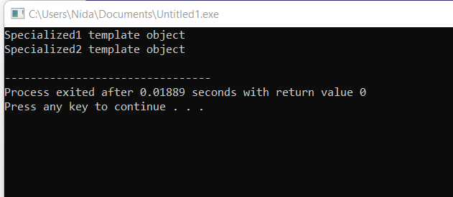

Slide 74
Common Applications
Stack
Queue
Other data structures

Slide 75
Next Lecture
STL!

